Slide 1

MACHINE INTELLIGENCE
Dr. N MEHALA
Department of Computer Science and Engineering

Slide 2

MACHINE INTELLIGENCE
Module 4 [Unsupervised Learning]
Dr. N MEHALA
Department of Computer Science and Engineering

Slide 3
MACHINE INTELLIGENCE
FP GROWTH ALGORITHM

Slide 4
MACHINE INTELLIGENCE
FP Growth Algorithm
Use a compressed representation of the database using an FP-tree
FP-Growth: allows frequent item set discovery without candidate item set generation
Two step approach:
Step 1: Build a compact data structure called the FP-tree
- Built using 2 passes over the data-set.
Step 2: Extracts frequent item sets directly from the FP-tree
- Traversal through FP-Tree
Once an FP-tree has been constructed, it uses a recursive divide-and-conquer approach to mine the frequent item sets

Slide 5
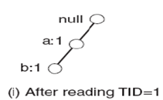
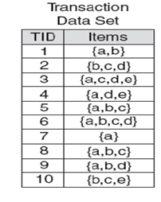
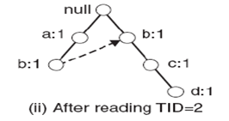
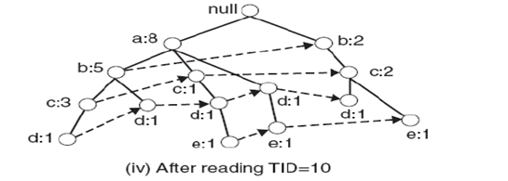
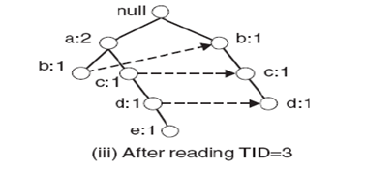
MACHINE INTELLIGENCE
STEP1 : FP-Tree construction (Example)
Pointers are maintained between
nodes containing the same item,
creating singly linked lists (dotted
lines)
The more paths that overlap, the
higher the compression. FP-tree may
fit in memory.
Frequent itemsets are extracted from
the FP-Tree.

Slide 6
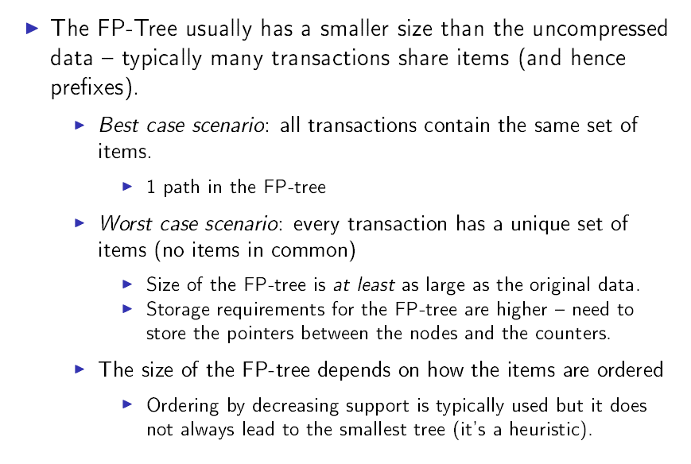
MACHINE INTELLIGENCE
FP Tree Zize

Slide 7
MACHINE INTELLIGENCE
Dr. N MEHALA
Department of Computer Science and Engineering

Slide 8
MACHINE INTELLIGENCE
Module 4 [Unsupervised Learning]
Dr. N MEHALA
Department of Computer Science and Engineering

Slide 9
MACHINE INTELLIGENCE
FP GROWTH ALGORITHM

Slide 10
MACHINE INTELLIGENCE
STEP2: Frequent Item Generation

Slide 11
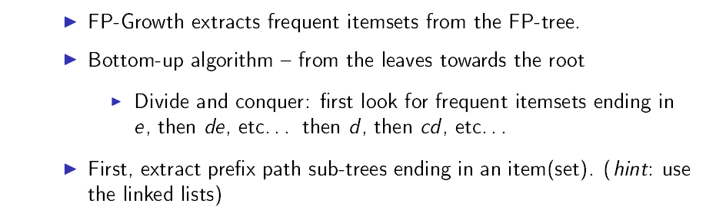
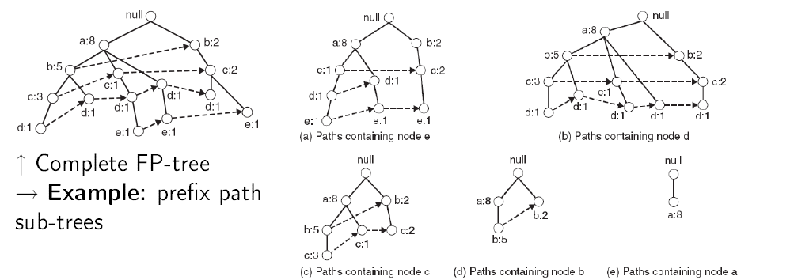
MACHINE INTELLIGENCE
STEP2: Frequent Item Generation

Slide 12
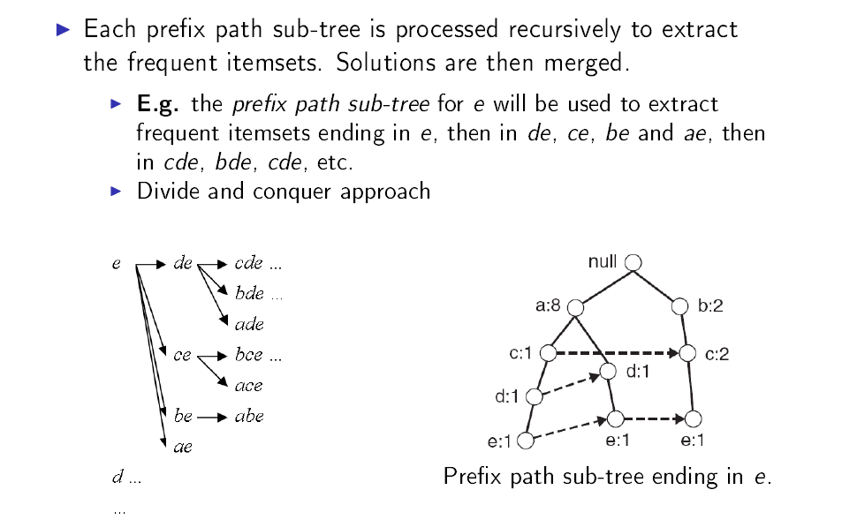
MACHINE INTELLIGENCE
STEP2: Frequent Item Generation

Slide 13
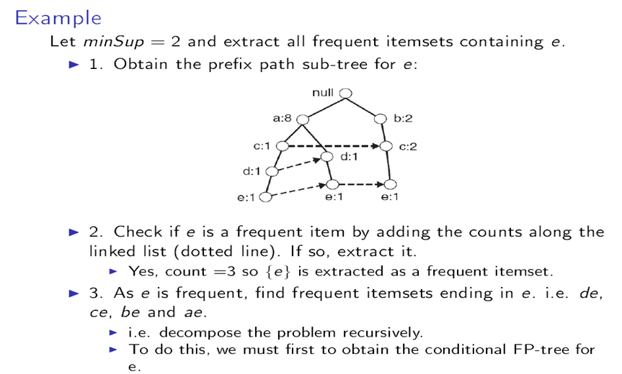
MACHINE INTELLIGENCE
STEP2: Frequent Item Generation

Slide 14
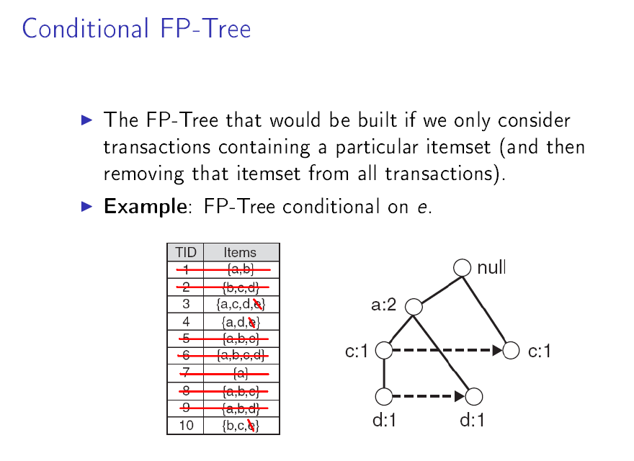
MACHINE INTELLIGENCE
STEP2: Frequent Item Generation

Slide 15
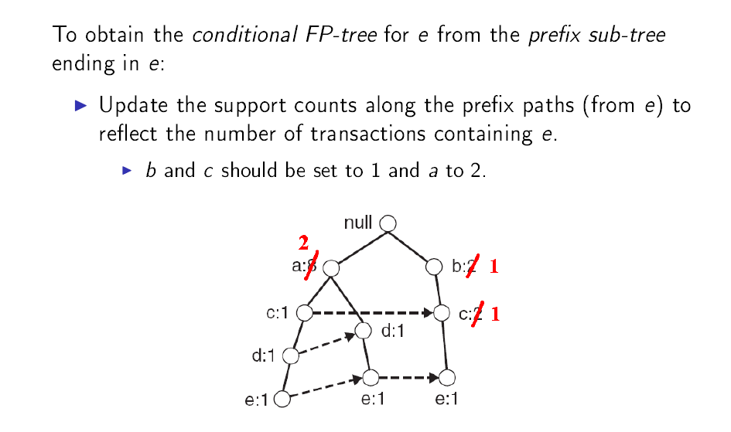
MACHINE INTELLIGENCE
STEP2: Frequent Item Generation

Slide 16
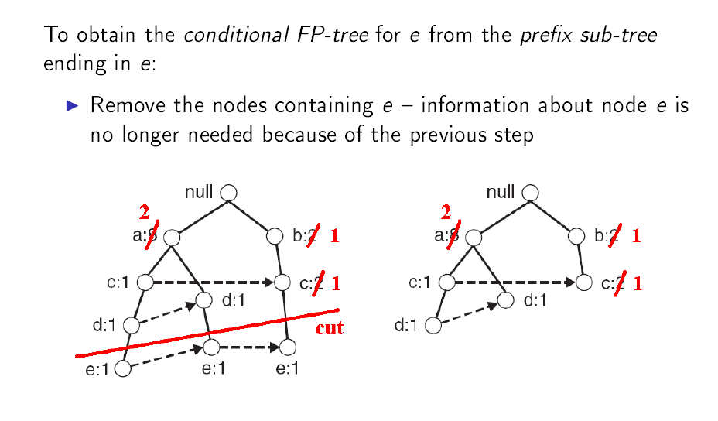
MACHINE INTELLIGENCE
STEP2: Frequent Item Generation

Slide 17
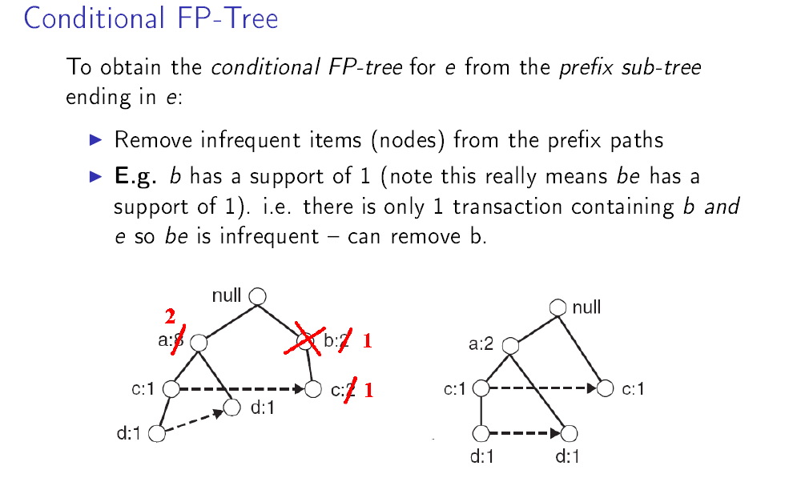
MACHINE INTELLIGENCE
STEP2: Frequent Item Generation

Slide 18
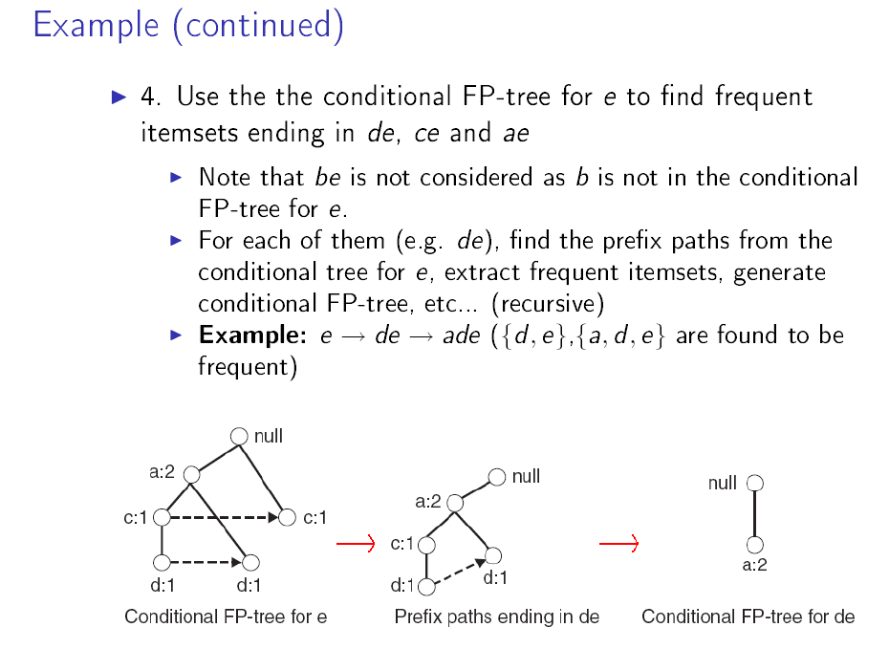
MACHINE INTELLIGENCE
STEP2: Frequent Item Generation

Slide 19
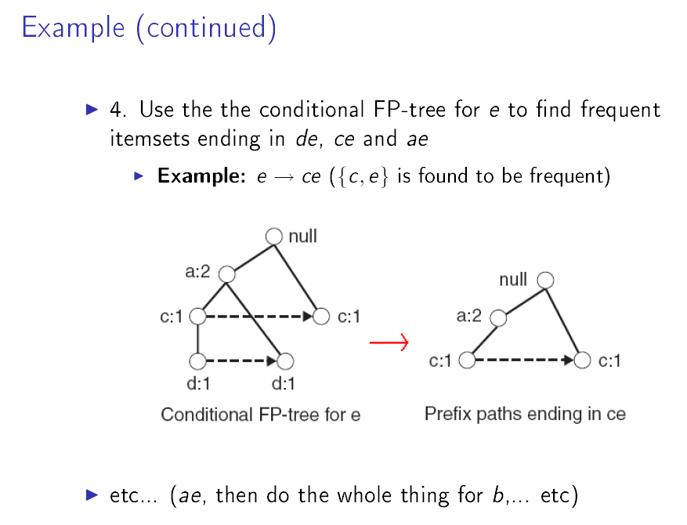
MACHINE INTELLIGENCE
STEP2: Frequent Item Generation

Slide 20
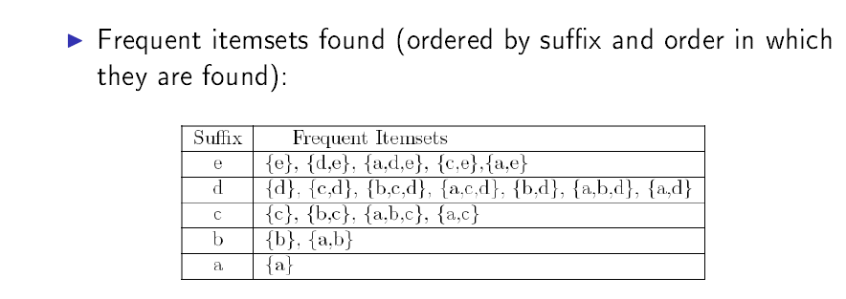
MACHINE INTELLIGENCE
STEP2: Frequent Item Generation

Slide 21
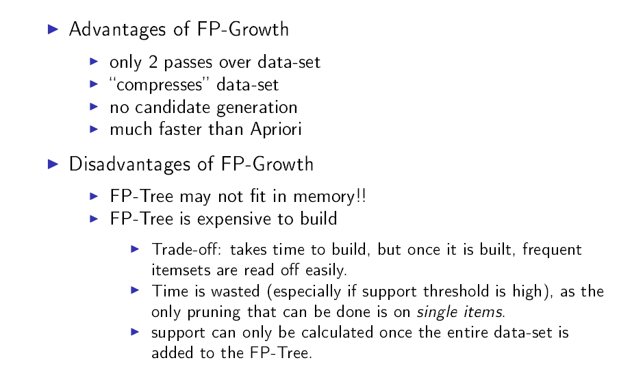
MACHINE INTELLIGENCE
Discussion

Slide 22
MACHINE INTELLIGENCE
Summary

Slide 23
MACHINE INTELLIGENCE
Resources
http://www2.ift.ulaval.ca/~chaib/IFT-4102-7025/public_html/Fichiers/Machine_Learning_in_Action.pdf
http://wwwusers.cs.umn.edu/~kumar/dmbook/.
ftp://ftp.aw.com/cseng/authors/tan
http://web.ccsu.edu/datamining/resources.html

Slide 24
THANK YOU
Dr. N MEHALA
Department of Computer Science and Engineering
mehala@pes.edu

